Slide 1
Time-lapse Mining from Internet Photos Ricardo Martin-Brualla
DELIVERED BY YANG HAORAN

Slide 2
MOTIVATION and aim
Time-lapse photography need a lot of time to collect photos.
However, The internet has innumerable photos, so we can use the photos taken by different people to from a short video.

Slide 3
Algorithm outline
input: photos collected from internet.
output: a number of videos
Procedure:
1. cluster the photos based on their geolocations into landmarks.
2. for each landmark , get camera parameters using Structure-from-Motion techniques 3. find popular viewpoints, called Reference Image
4. for each reference image, find “nearby” images with similar viewpoints and directions
5. correct the photos for different viewpoints with respect to the reference image.
6. stabilize the appearance of the warped images to correct for different lighting conditions and occluders

Slide 4
EXPLANATION
Procedure 1. cluster the photos based on their geolocations into landmarks.

Slide 5
EXPLANATION
Procedure 2. compute 3D reconstructions using Structure-from-Motion techniques.
Aim of Procedure2:
Get camera parameters
Intrinsic camera parameters
Extrinsic camera parameters

Slide 6
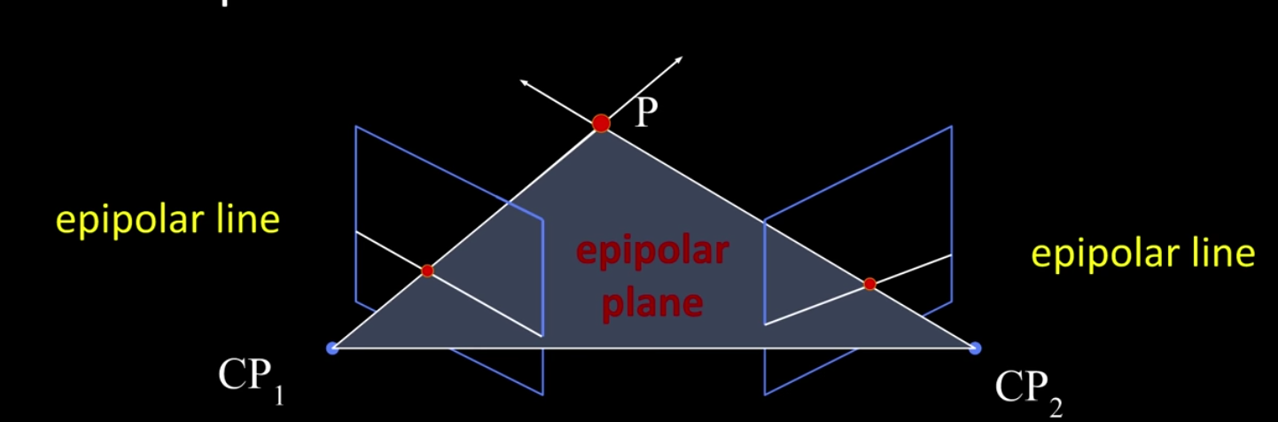
SFM(STRUCTURE FORM MOTHION)

Slide 7
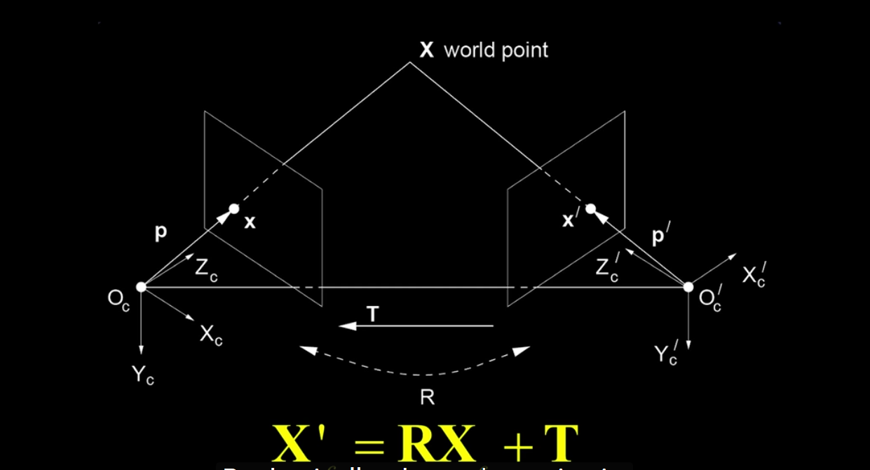
SFM(STRUCTURE FORM MOTHION)

Slide 8
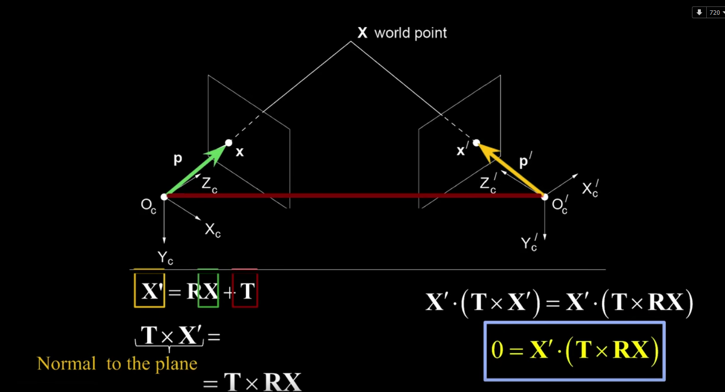

Slide 9
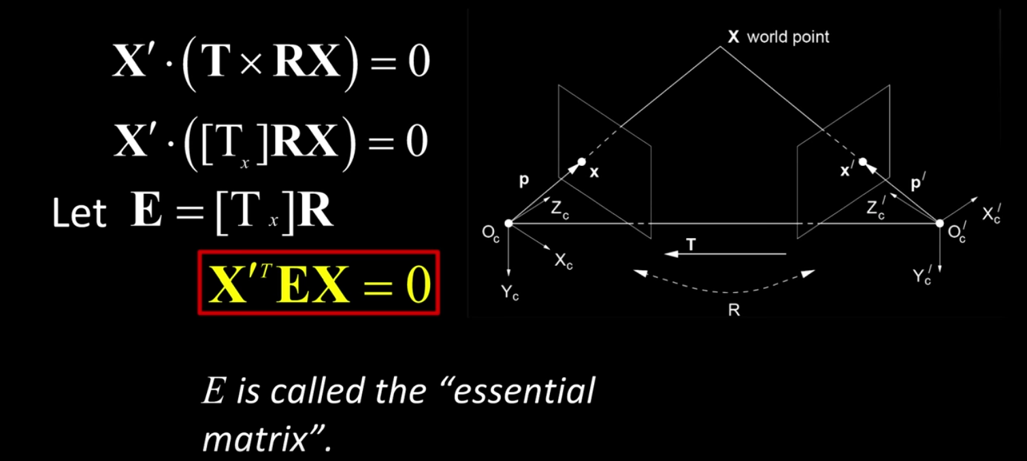
SFM(STRUCTURE FORM MOTHION)

Slide 10
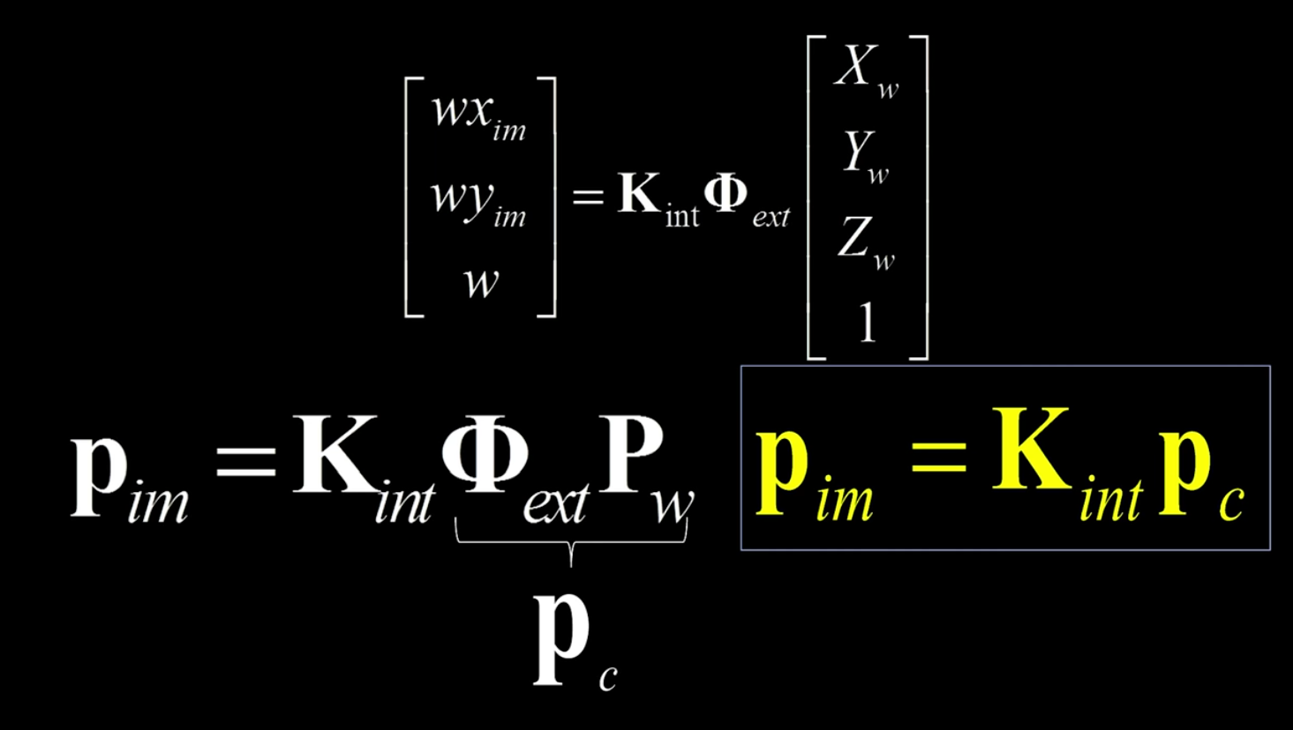
SFM(STRUCTURE FORM MOTHION)

Slide 11
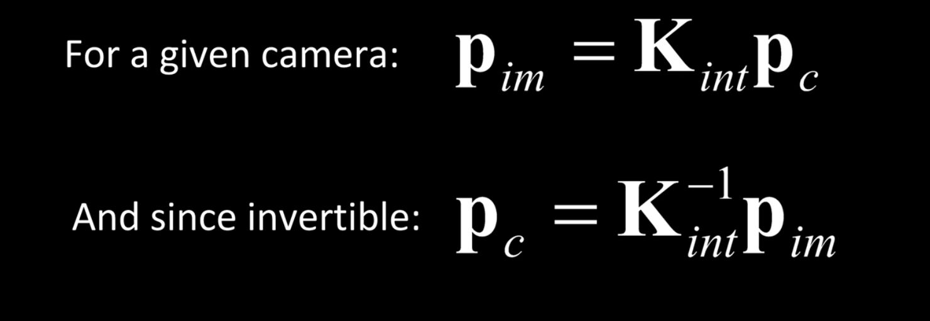
SFM(STRUCTURE FORM MOTHION)

Slide 12
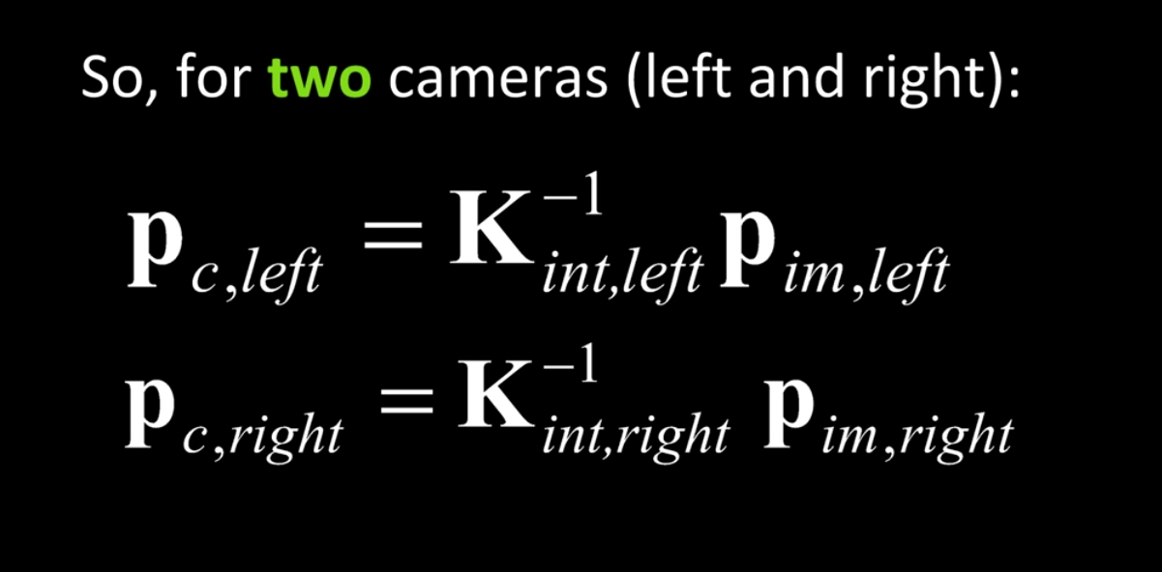
SFM(STRUCTURE FORM MOTHION)

Slide 13
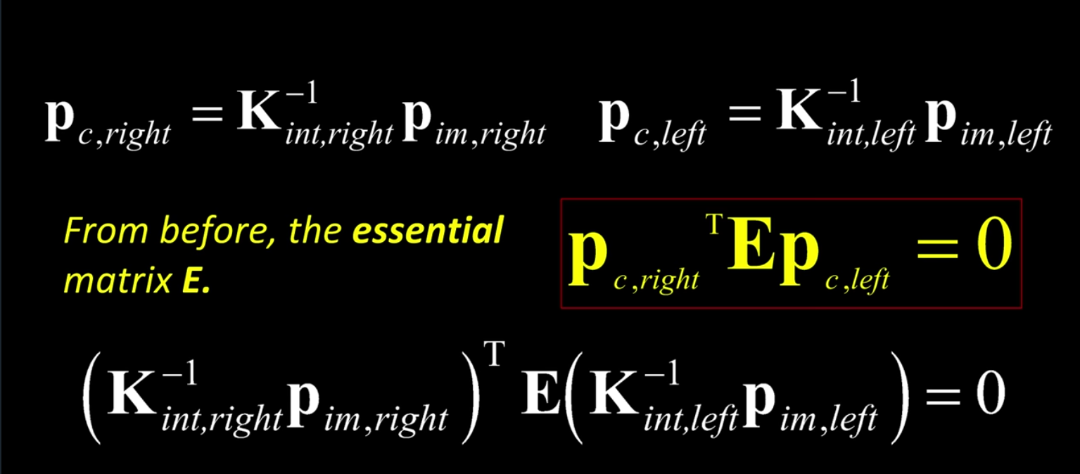
SFM(STRUCTURE FORM MOTHION)

Slide 14
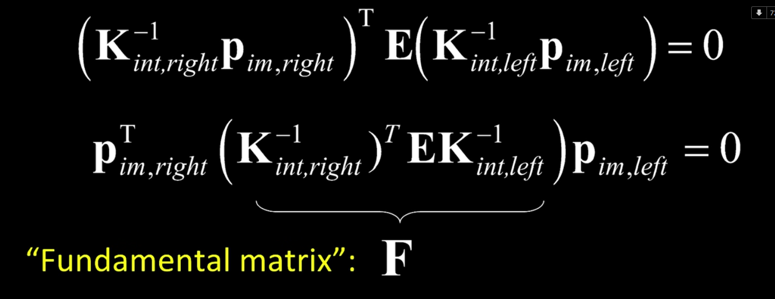
SFM(STRUCTURE FORM MOTHION)

Slide 15
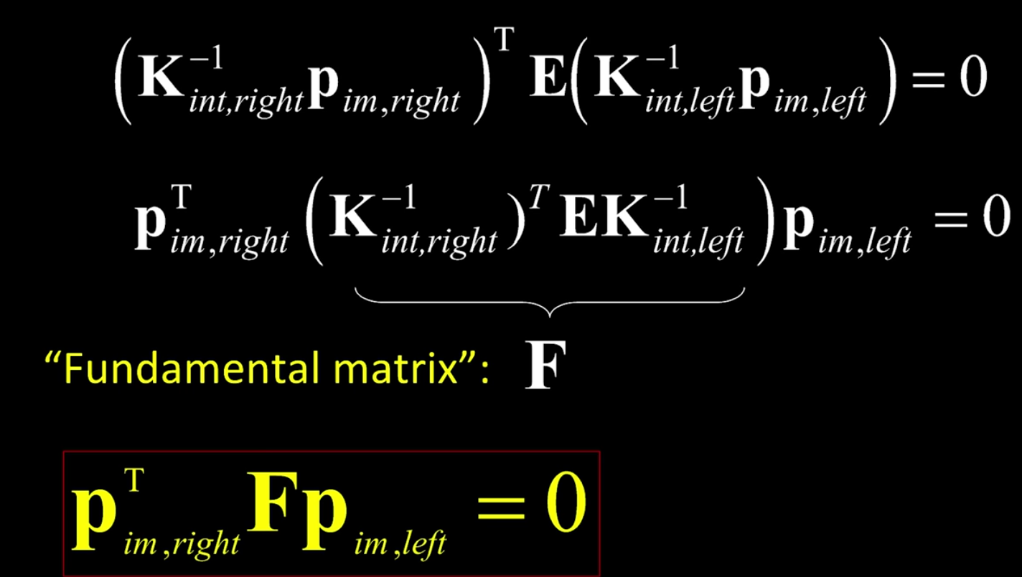
SFM(STRUCTURE FORM MOTHION)

Slide 16
SFM(STRUCTURE FORM MOTHION)
Input: A series of images, for the same scene
Output: Camera parameters
Procedure:
1. Obtain camera intrinsic matrix
2. Feature points matching(SIFT)
3. Calculate fundamental matrix
4. Calculate camera extrinsic matrix

Slide 17
EXPLANATION
Procedure 3. find popular viewpoints, called Reference Image.
Analyzing SIFT feature co-occurrences to partition the set of images
into groups of photos with similar content and viewpoint.
Representative images are then chosen for each group, by finding
images that share the most features within the group.

Slide 18
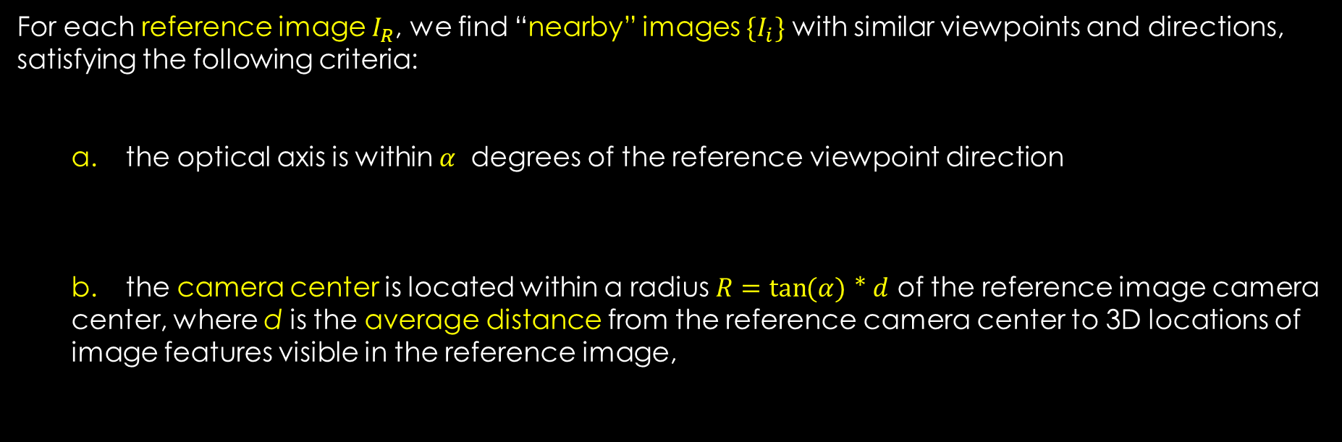
EXPLANATION
Procedure 4. for each reference image, find “nearby” images with similar viewpoints and directions
For each reference image $I_{R}$, we find “nearby” images $\{I_{i}\}$ with similar viewpoints and directions, satisfying the following criteria:
a. the optical axis is within $α$ degrees of the reference viewpoint direction
b. the camera center is located within a radius $R=\tan{(α)}$ * $d$ of the reference image camera center, where d is the average distance from the reference camera center to 3D locations of image features visible in the reference image,

Slide 19
EXPLANATION
Procedure 5. correct the photos for different viewpoints with respect to the reference image
Method 1. RANSAC
This baseline method works well for scenes without parallax, but as expected, is not able to stabilize scenes with larger depth variations.
Method 2. temporal version of the classical plane sweep multi-view stereo algorithm
Minimize a matching cost

Slide 20
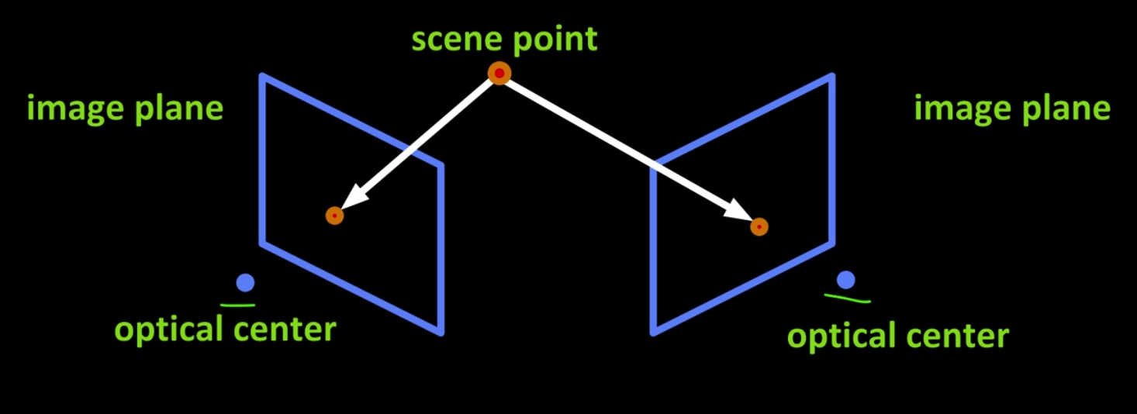
PRINCIPLE OF Method 2

Slide 21
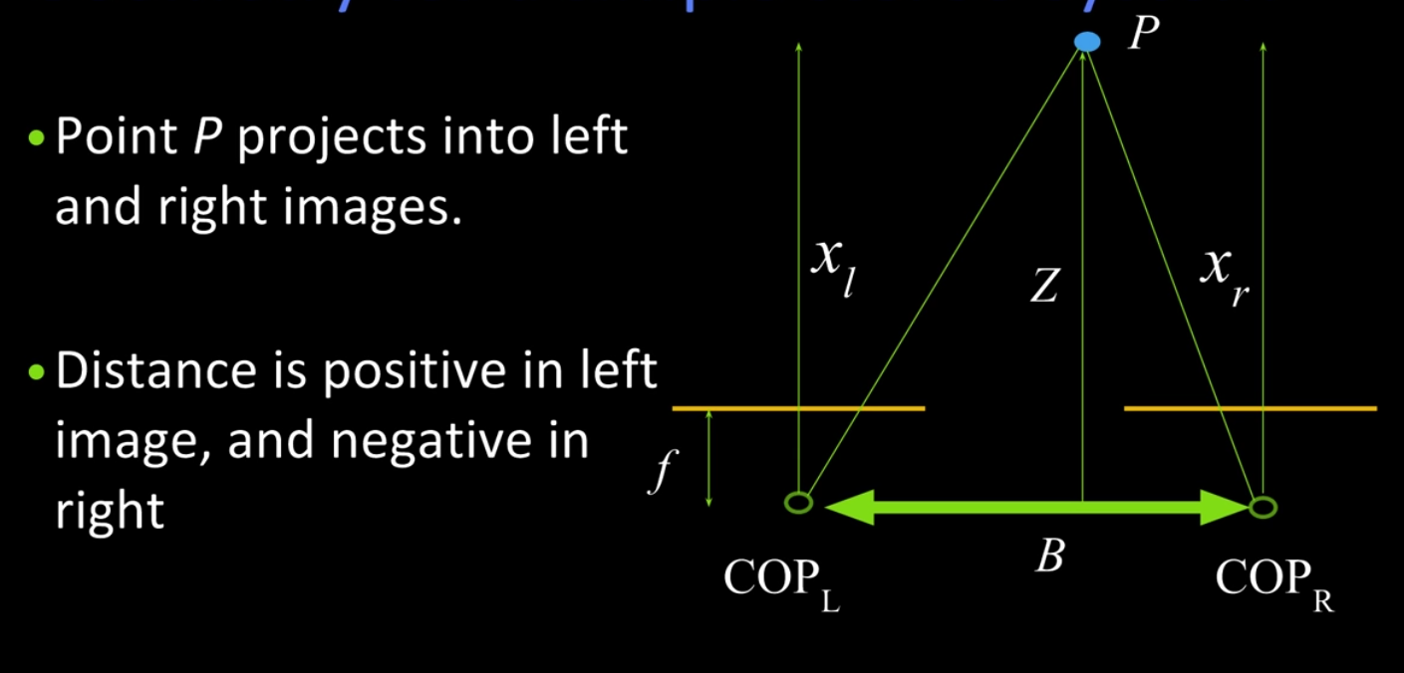
PRINCIPLE OF Method 2

Slide 22
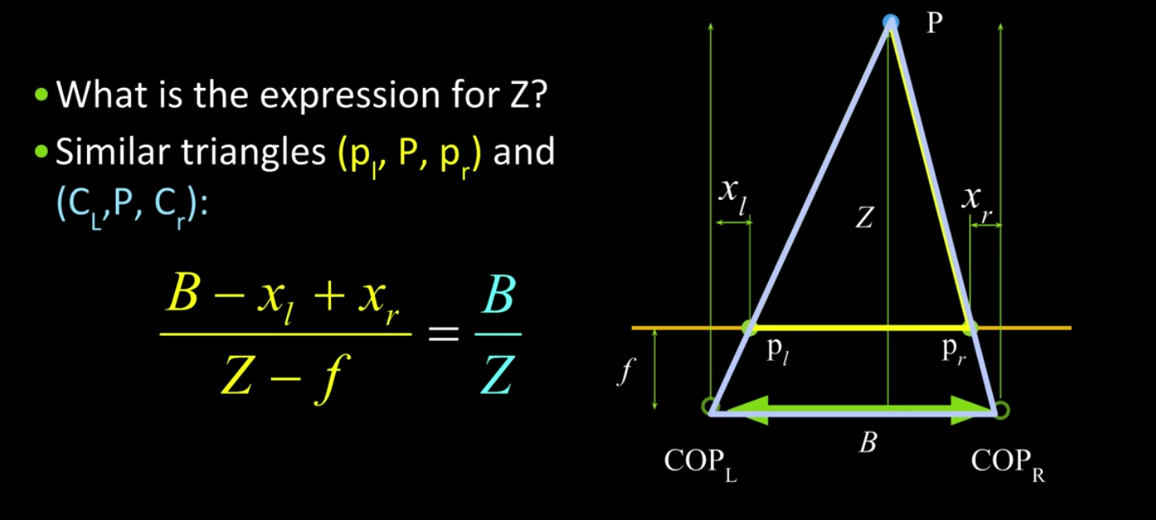
PRINCIPLE OF Method 2

Slide 23
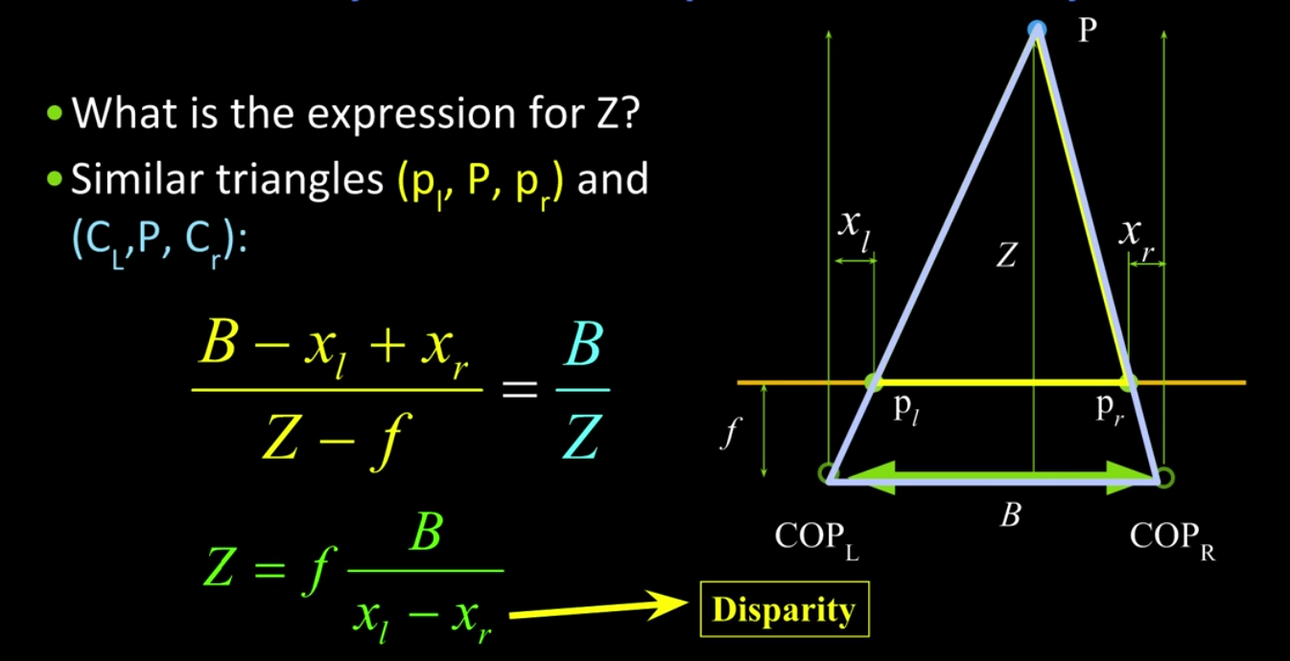
PRINCIPLE OF Method 2

Slide 24
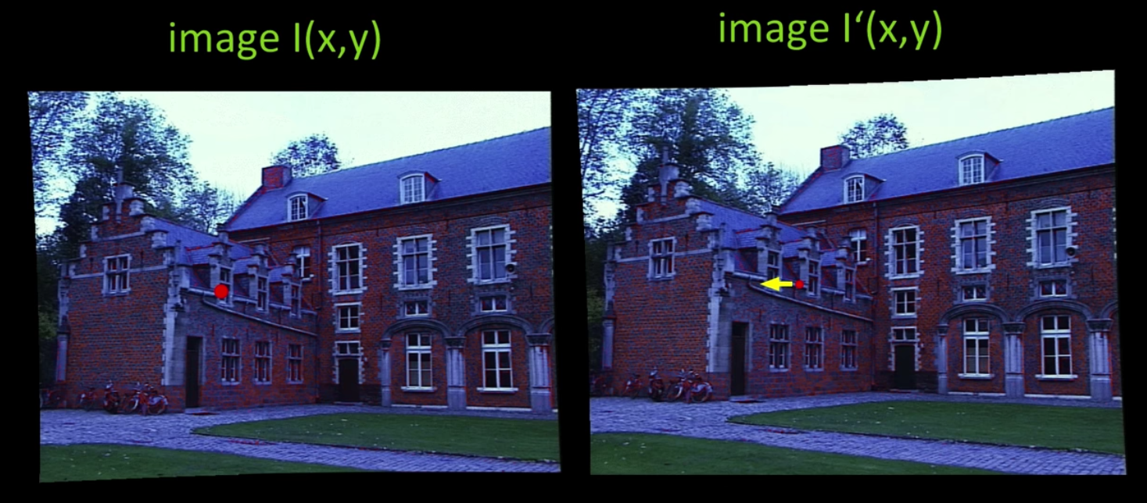
PRINCIPLE OF Method 2

Slide 25
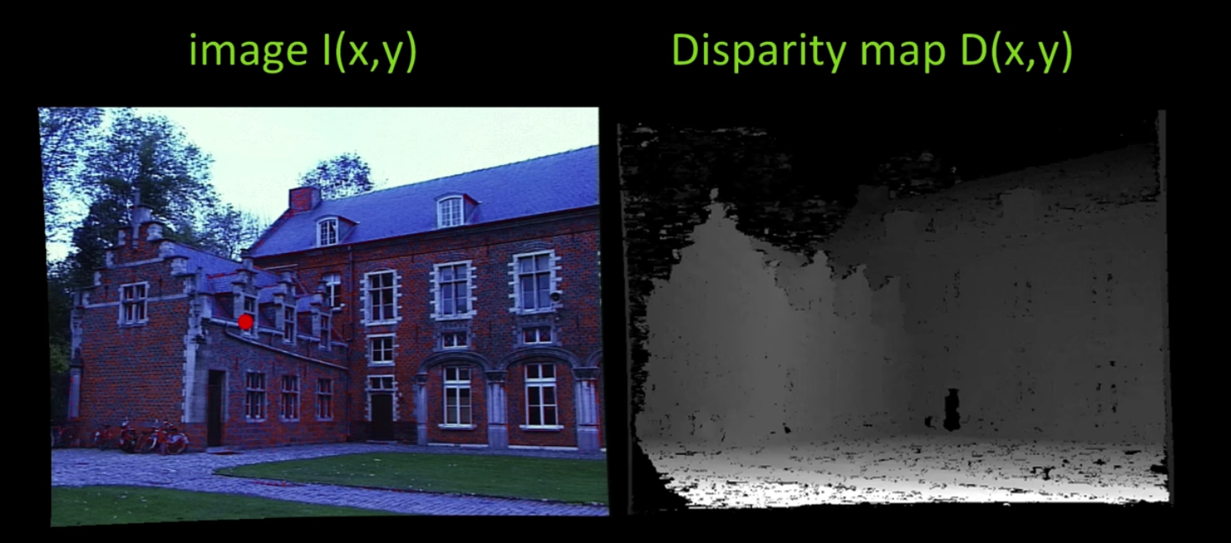
PRINCIPLE OF Method 2

Slide 26
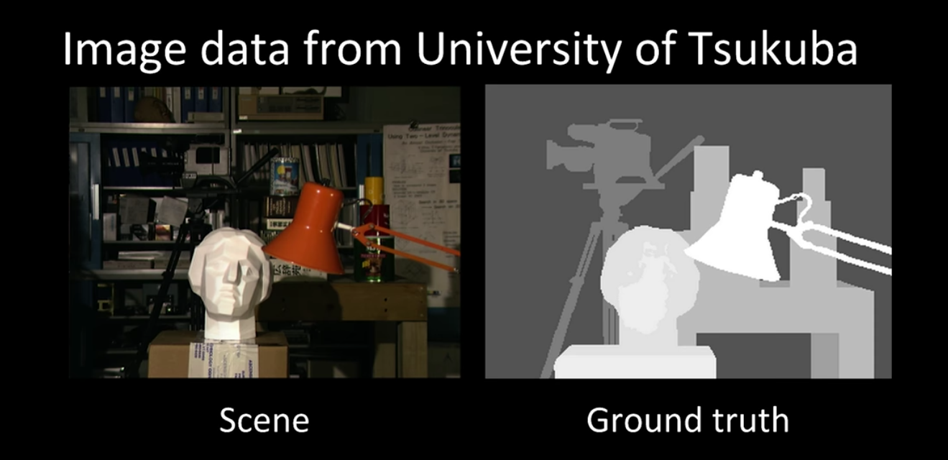
PRINCIPLE OF Method 2

Slide 27
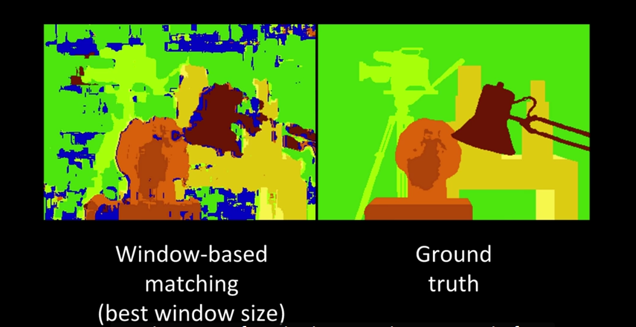
PRINCIPLE OF Method 2

Slide 28
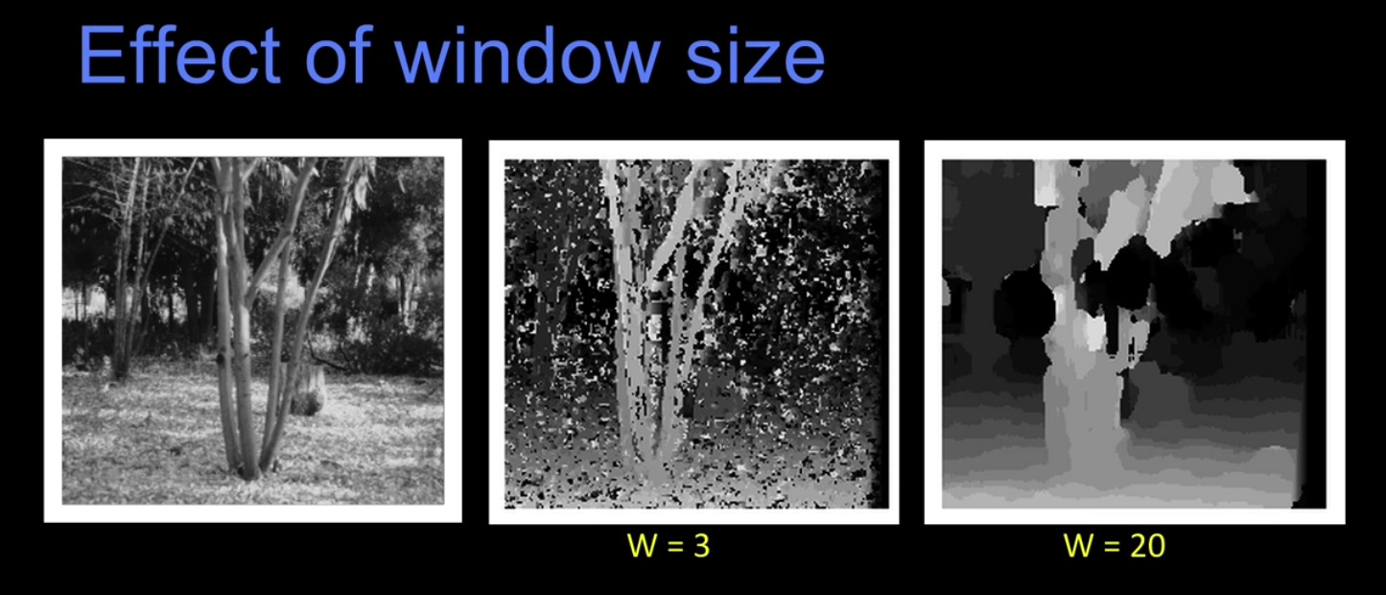
PRINCIPLE OF Method 2

Slide 29
PRINCIPLE OF Method 2
Beyond individual correspondences to estimate disparities:
Optimize correspondences assignments jointly
a. Scanline at a time (DP)
b. Full 2D grid (graph cuts)

Slide 30
Full 2D grid (graph cuts)
What defines a good stereo correspondences:
1. Match quality – Want a pixel to find a good appearance match in the other image.
2. Smoothness -- if two pixels are adjacent, they should (usually) move about the same amount.

Slide 31
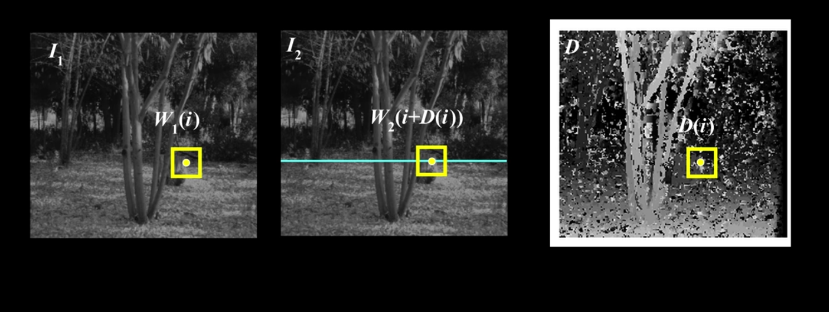
Full 2D grid (graph cuts)

Slide 32
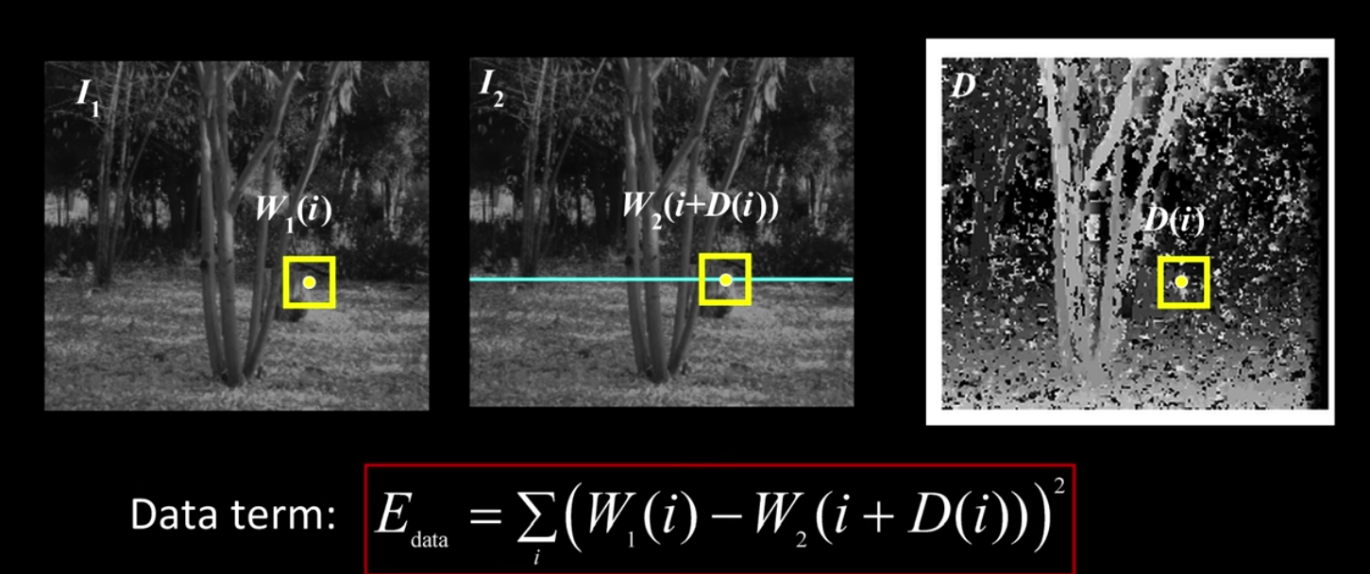
Full 2D grid (graph cuts)

Slide 33
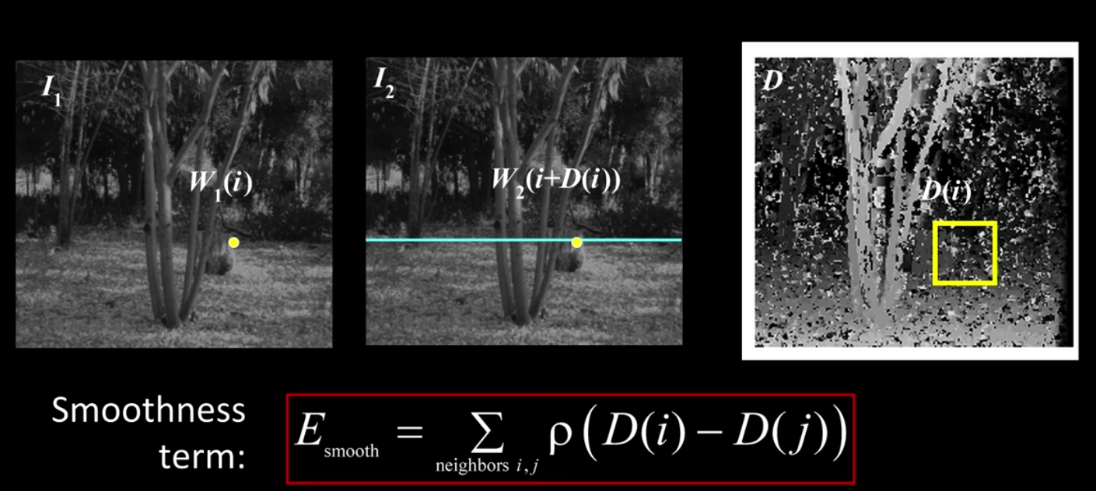
Full 2D grid (graph cuts)

Slide 34
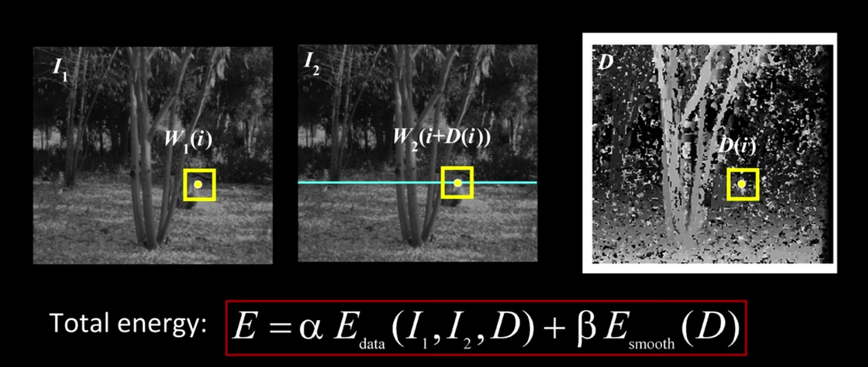
Full 2D grid (graph cuts)

Slide 35
EXPLANATION
Procedure 6. stabilize the appearance of the warped images to correct for different lighting conditions and occluders .
Method 1. median filtering for video.
drawbacks: We found that large temporal windows are needed to reduce flicker but also result in oversmoothed transitions.
Method 2. a new temporal regularization approach

Slide 36
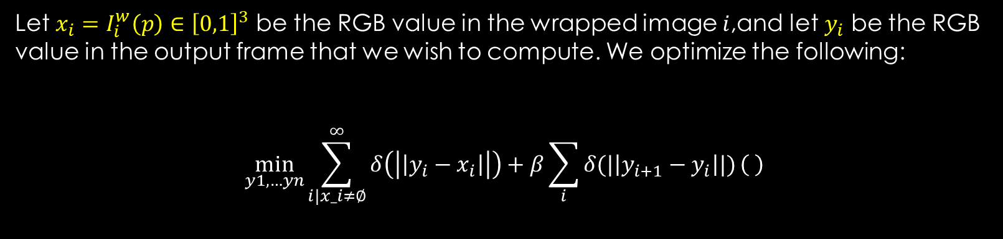
Method 2.
Let $x_{i}=I_{i}^{w}\left(p\right)∈{\left[0,1\right]}^{3}$ be the RGB value in the wrapped image $i$,and let $y_{i}$ be the RGB value in the output frame that we wish to compute. We optimize the following:
$$\min_{y1,…yn}{\sum_{i|x_i≠∅}^{∞}{δ\left(\left|\left|y_{i}−x_{i}\right|\right|\right)+β\sum_{i}{δ(|\left|y_{i+1}−y_{i}\right||)}\left( \right)}}$$

Slide 37
THANKS

